Slide 1
Natural Language Processing with RNNs and Attention
Dr. Sifat Momen

Slide 2
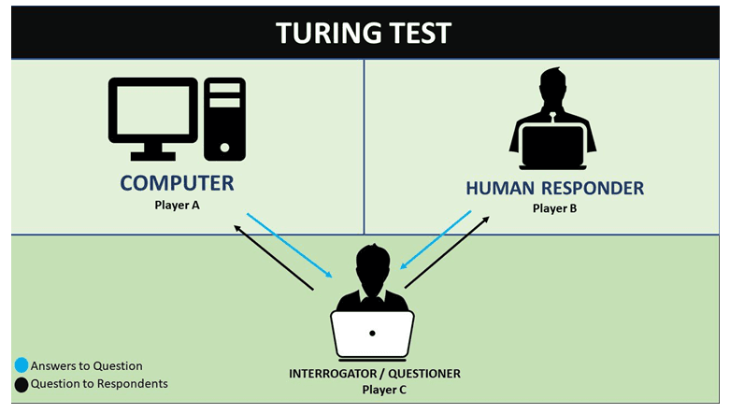
Turing test
The Turing Test, originally proposed by Alan Turing, is a method for determining if a machine can exhibit intelligent behavior indistinguishable from that of a human, involving a human evaluator trying to identify a machine from a human through text-based conversation.
Alan Turing could have tested for many things, such as the ability to recognize cats in pictures, play chess, or escape a maze, but he chose a linguistic task.
The test highlights the fact that mastering language is arguably Homo sapien’s greatest cognitive ability.

Slide 3
Turing test
The Turing Test, originally proposed by Alan Turing, is a method for determining if a machine can exhibit intelligent behavior indistinguishable from that of a human, involving a human evaluator trying to identify a machine from a human through text-based conversation.
Alan Turing could have tested for many things, such as the ability to recognize cats in pictures, play chess, or escape a maze, but he chose a linguistic task.
The test highlights the fact that mastering language is arguably Homo sapien’s greatest cognitive ability.
Can we build a machine that can read and write natural language?

Slide 4
Turing test
The Turing Test, originally proposed by Alan Turing, is a method for determining if a machine can exhibit intelligent behavior indistinguishable from that of a human, involving a human evaluator trying to identify a machine from a human through text-based conversation.
Alan Turing could have tested for many things, such as the ability to recognize cats in pictures, play chess, or escape a maze, but he chose a linguistic task.
The test highlights the fact that mastering language is arguably Homo sapien’s greatest cognitive ability.
Can we build a machine that can read and write natural language?
A common approach for natural language tasks is to use RNNs.

Slide 5
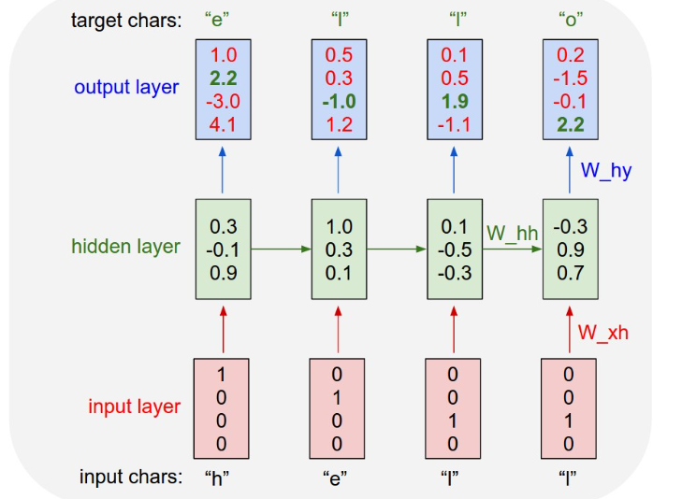
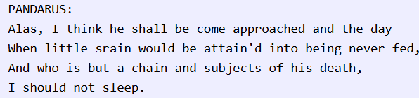
Generating Shakespearean Text using a Character RNN
In the 2015 blog post, Andrej Karpathy showed how to train an RNN to predict the next character in a sentence.
Blog Title: The Unreasonable Effectiveness of Recurrent Neural Networks
Link: https://karpathy.github.io/2015/05/21/rnn-effectiveness/

Slide 6
Methodology
Download all of Shakespeare’s work
Encode every character as integer
Split the sequential dataset (90% train set)
Building and Training the Char-RNN Model
Generating Fake Shakespearean Text

Slide 7

Methodology
Download all of Shakespeare’s work
Encode every character as integer
Split the sequential dataset (90% train set)
Building and Training the Char-RNN Model
Generating Fake Shakespearean Text

Slide 8
Methodology
Download all of Shakespeare’s work
Encode every character as integer
Split the sequential dataset (90% train set)
Building and Training the Char-RNN Model
Generating Fake Shakespearean Text

Slide 9
Methodology
Download all of Shakespeare’s work
Encode every character as integer
Split the sequential dataset (90% train set)
Building and Training the Char-RNN Model
Generating Fake Shakespearean Text

Slide 10
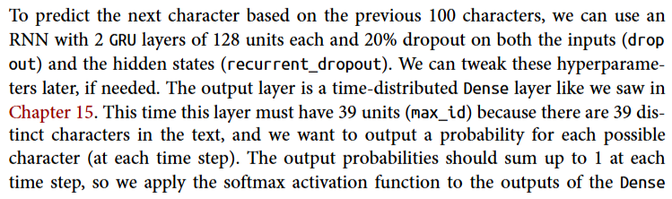
Methodology
Download all of Shakespeare’s work
Encode every character as integer
Split the sequential dataset (90% train set)
Building and Training the Char-RNN Model
Generating Fake Shakespearean Text

Slide 11
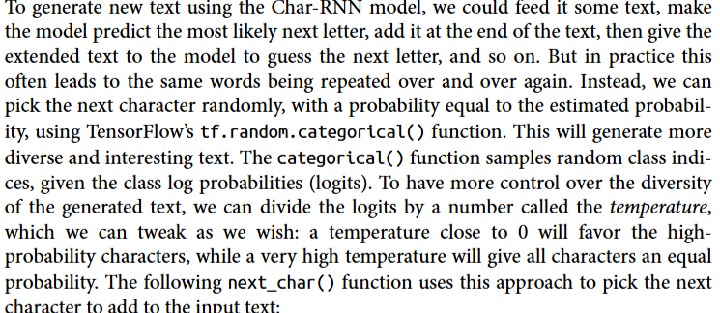
Methodology
Download all of Shakespeare’s work
Encode every character as integer
Split the sequential dataset (90% train set)
Building and Training the Char-RNN Model
Generating Fake Shakespearean Text

Slide 12
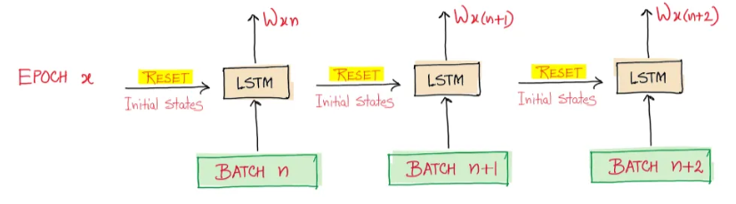
Stateless vs. Stateful RNNs

Slide 13
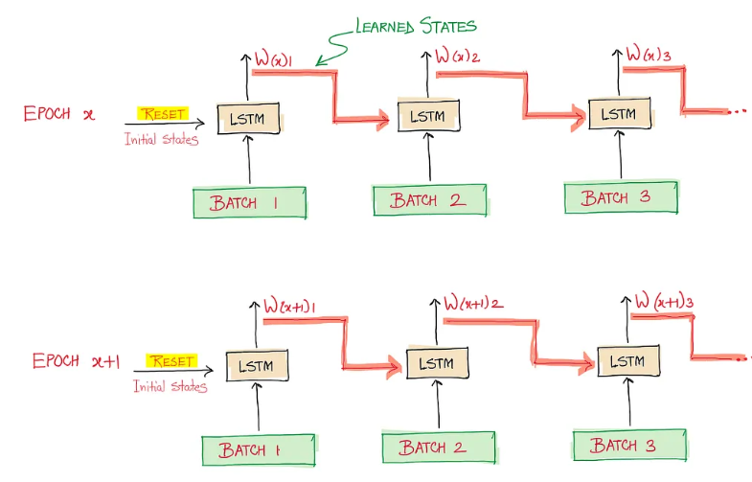
Stateless vs. Stateful RNNs

Slide 14
Statless vs. Stateful RNN
https://pub.towardsai.net/stateless-vs-stateful-lstms-265c83116c49

Slide 15
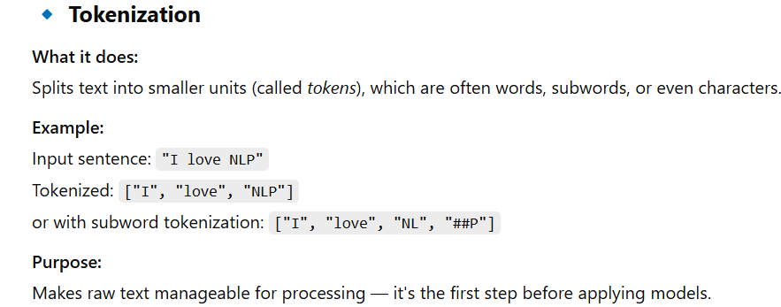
Tokenization vs. Word Embedding

Slide 16
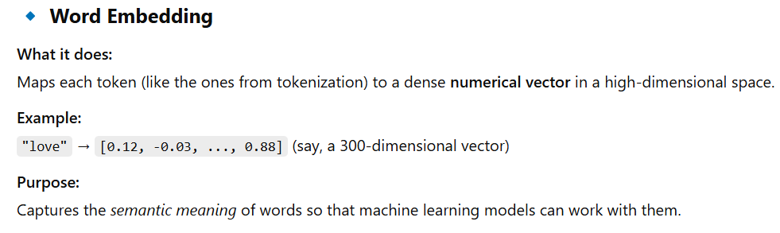
Tokenization vs. Word Embedding

Slide 17
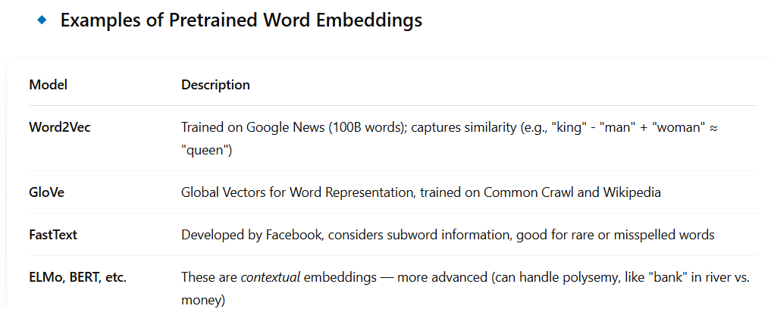
Pre-trained word embedding
https://patil-aakanksha.medium.com/top-5-pre-trained-word-embeddings-20de114bc26

Slide 18
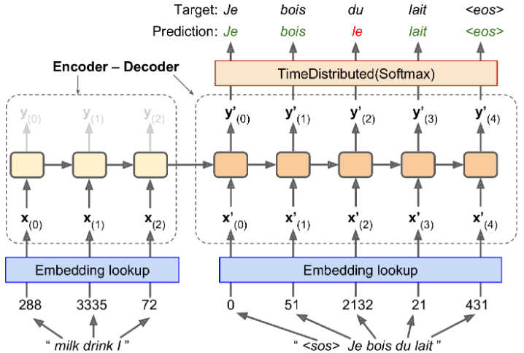
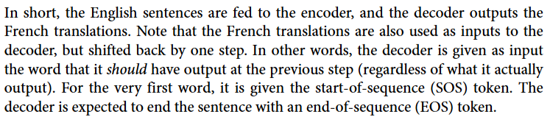
Neural Machine Translation (NMT)
An Encoder-Decoder Network for NMT

Slide 19
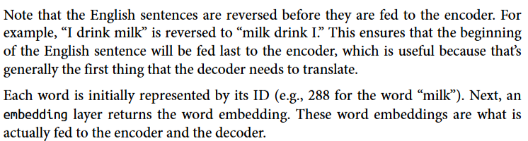
Neural Machine Translation (NMT)
An Encoder-Decoder Network for NMT

Slide 20
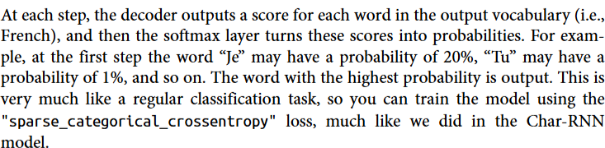
Neural Machine Translation (NMT)
An Encoder-Decoder Network for NMT

Slide 21
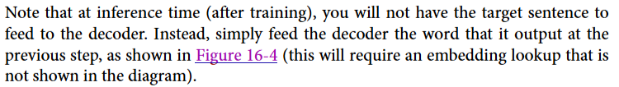
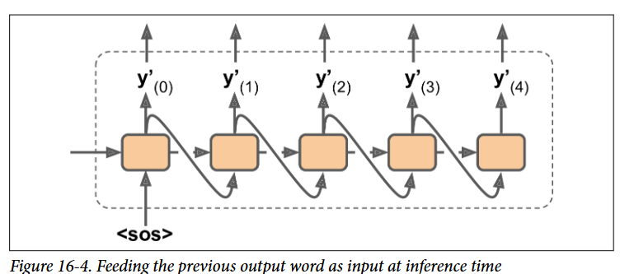
Neural Machine Translation (NMT)
An Encoder-Decoder Network for NMT

Slide 22
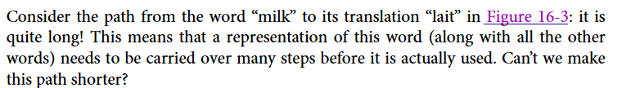
Attention Mechanism

Slide 23
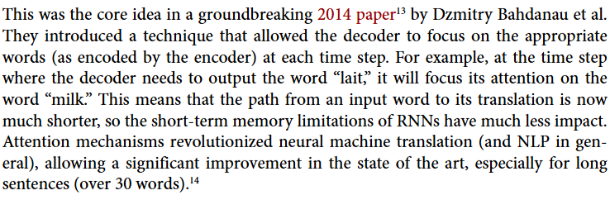
Attention Mechanism
https://arxiv.org/pdf/1409.0473

Slide 24
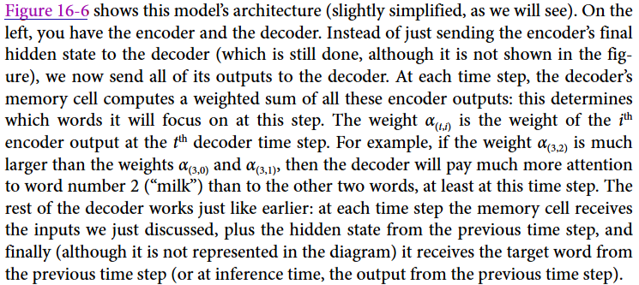
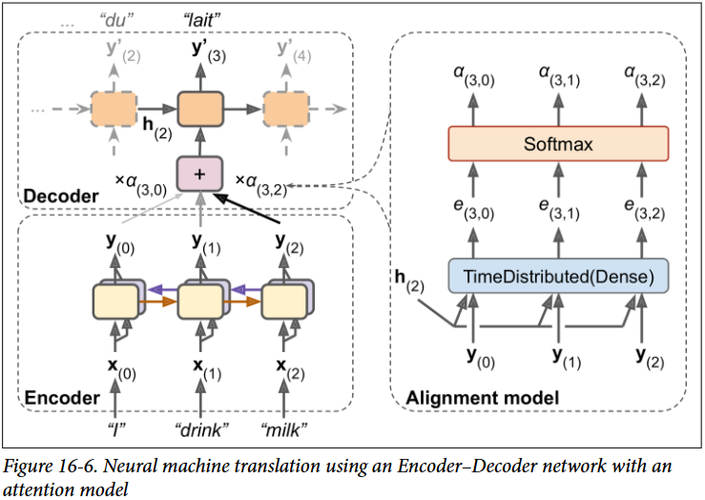
Attention Mechanism

Slide 25
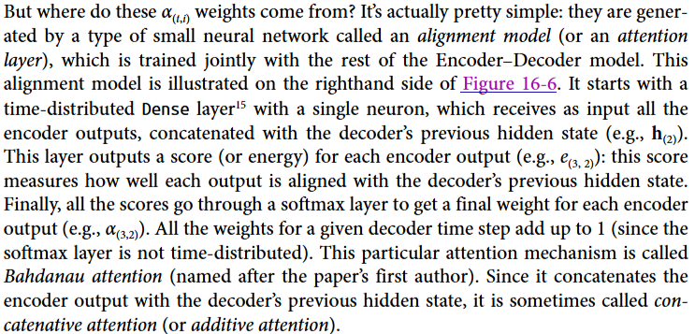
Attention Mechanism

